Slide 1

Advancing Water Quality Modeling with CE-QUAL-W2 for HAB Management
UNCLASSIFIED
Todd E. Steissberg, PhD, PE
Environmental Laboratory
Engineer Research and Development Center (ERDC)
U.S. Army Corps of Engineers
Co-PIs: Dr. Jodi Ryder, Dr. Emily Summers, Dr. Hailie Suk
5th Interagency Freshwater HAB R&D Workshop, Seattle, WA
September 23, 2025
UNCLASSIFIED

Slide 2
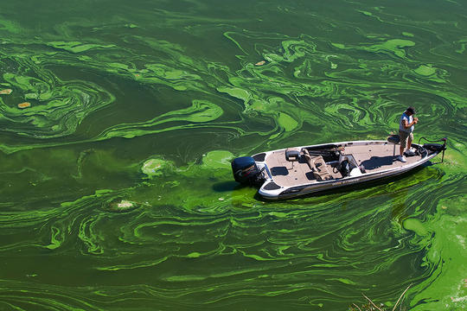
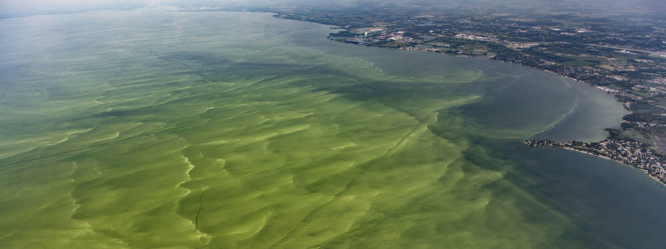
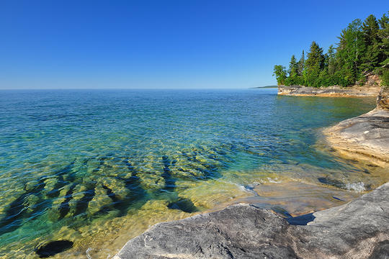
Introduction
Problem: Existing models inadequately predict the timing, frequency, intensity, spatial variability, and impacts of Harmful Algal Blooms (HABs).
Solution: New capabilities have been added to CE-QUAL-W2 to improve its ability to simulate and manage HABs.

Slide 3
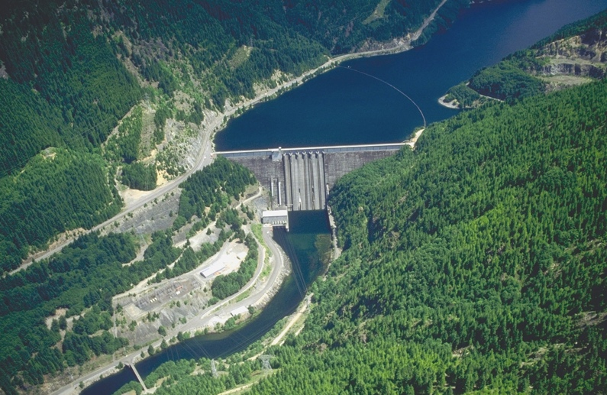

Challenges and Solutions
Developing HAB simulation capabilities applicable to any reservoir is challenging. Reservoirs have characteristics that can vary significantly:
Algal species
Water body morphometry (length, width, etc.)
Volume
Depth
Mixing dynamics (wind forcing, fetch orientation)
Harmful algal blooms can exhibit rapid changes and non-linear dynamics that are difficult to capture in model simulations.
To address these issues:
Extensive literature review. Feedback gathered from HAB experts.
Case study site (Detroit Lake, Oregon) was selected to provide adequate data and a range of conditions that enables development of scaling methods.
Single species selected for algorithm development.
Detroit Lake, Oregon
Detroit Lake HAB

Slide 4
Survey Results: CE-QUAL-W2 Development Opportunities

Slide 5
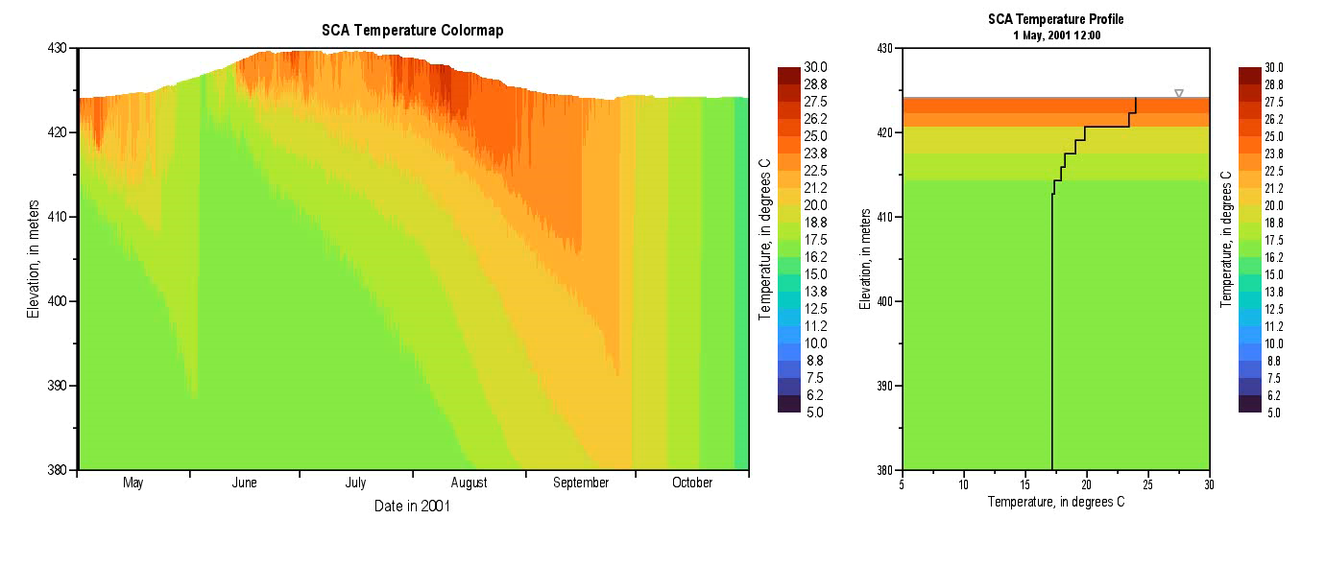
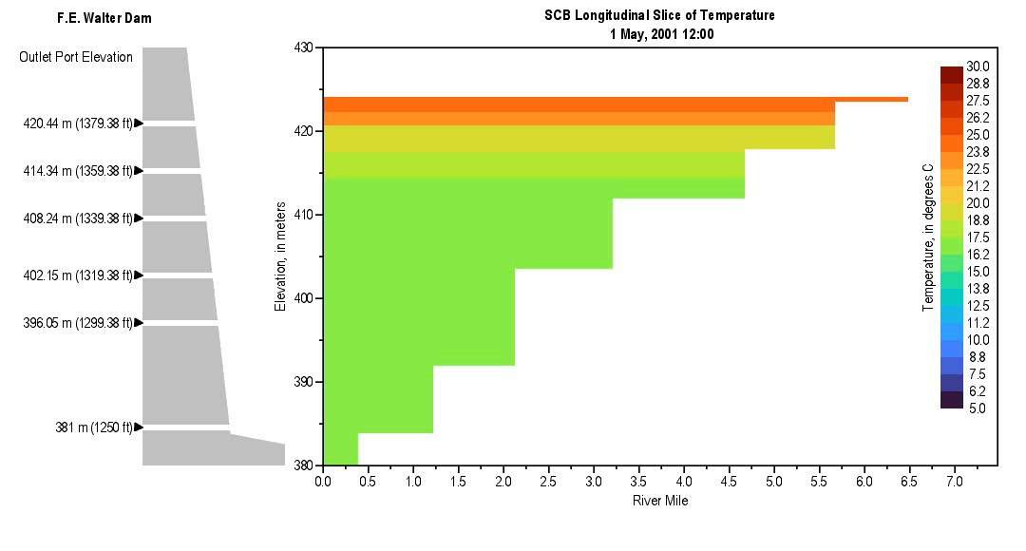
CE-QUAL-W2 Enhancements
Minimum algae concentration enforcement to support post-crash recovery.
Mechanical removal (treatments, harvesting) to simulate interventions such as skimming or pumping.
Hypoxia-induced mortality to reflect algal population dynamics under low oxygen stress.
Nitrogen fixation to support simulation of cyanobacteria dominance in low-nitrogen conditions. Cyanobacteria may outcompete native algae since they can fix nitrogen.
Improved buoyancy dynamics. Developing guidance for use.

Slide 6
Minimum Algae Concentration
Purpose: To prevent complete depletion of algae due to high mortality events, enabling post-bloom recovery in the absence of boundary-driven reintroduction.
Implementation:
A user-defined floor value for algal biomass is enforced after each time step.
The logic is embedded within the wqconstituents.f90 file and applied across all layers and segments where algal concentrations fall below the minimum.
An optional input parameter allows global or group-specific specification of the threshold.
The minimum value acts as a lower bound; once concentrations fall below it due to mortality or other sinks, they are reset to the threshold for subsequent time steps.

Slide 7
Mechanical Removal (Algal Harvesting and Other Treatments)
Purpose: To simulate segment-specific algal biomass removal, reflecting surface skimming, pumping, or other mechanical control actions.
Implementation:
New input file harvest_option_input.csv defines the active segments, interpolation method, and time-series file path.
A time-varying file (e.g., algal_harvesting_time-series.csv) provides fractional reductions by segment and simulation day.
Variables are declared in w2modules.f90, and logic is added to input.f90, time-varying-data.f90, and wqconstituents.f90.
Removal is implemented as an instantaneous fractional reduction in the algal state variables during the time step corresponding to the input.

Slide 8
Hypoxia-Induced Mortality
Purpose: To increase algal mortality in response to low dissolved oxygen (DO), reflecting physiological stress and bloom collapse under hypoxic conditions.
Implementation:
Logic added to algal growth and mortality routines to apply increased death rate when DO falls below a user-defined threshold.
Supports multiple response forms: step function, linear scaling, or Monod-style inhibition.
Applies uniformly to all algae in affected segments unless otherwise configured.

Slide 9
Nitrogen Fixation
Purpose: To simulate atmospheric nitrogen uptake by diazotrophic algae under nitrogen-limited conditions.
Implementation:
Optional activation per algal group, enabled through user input.
Adds a supplementary nitrogen source term when DIN concentrations fall below a user-defined threshold.
Internal logic uses a Monod-like function to modulate fixation rate based on DIN availability.
Ensures conservation of mass and allows continuous algal growth in nitrogen-limited but phosphorus-replete environments.

Slide 10
Results
Simulation | Value Turned ON | Value of New Input | Plot color
1 | -- Baseline -- | -- Baseline -- | Black
2 | ALG_O2LIM | 1.0 mg/L | Yellow
3 | ALG_MIN | 0.1 mg/L (biomass) | Blue
4 | CRIT_TIN | 1.5 mg/L | Red
5 | No new inputs | See above | Cyan

Slide 11
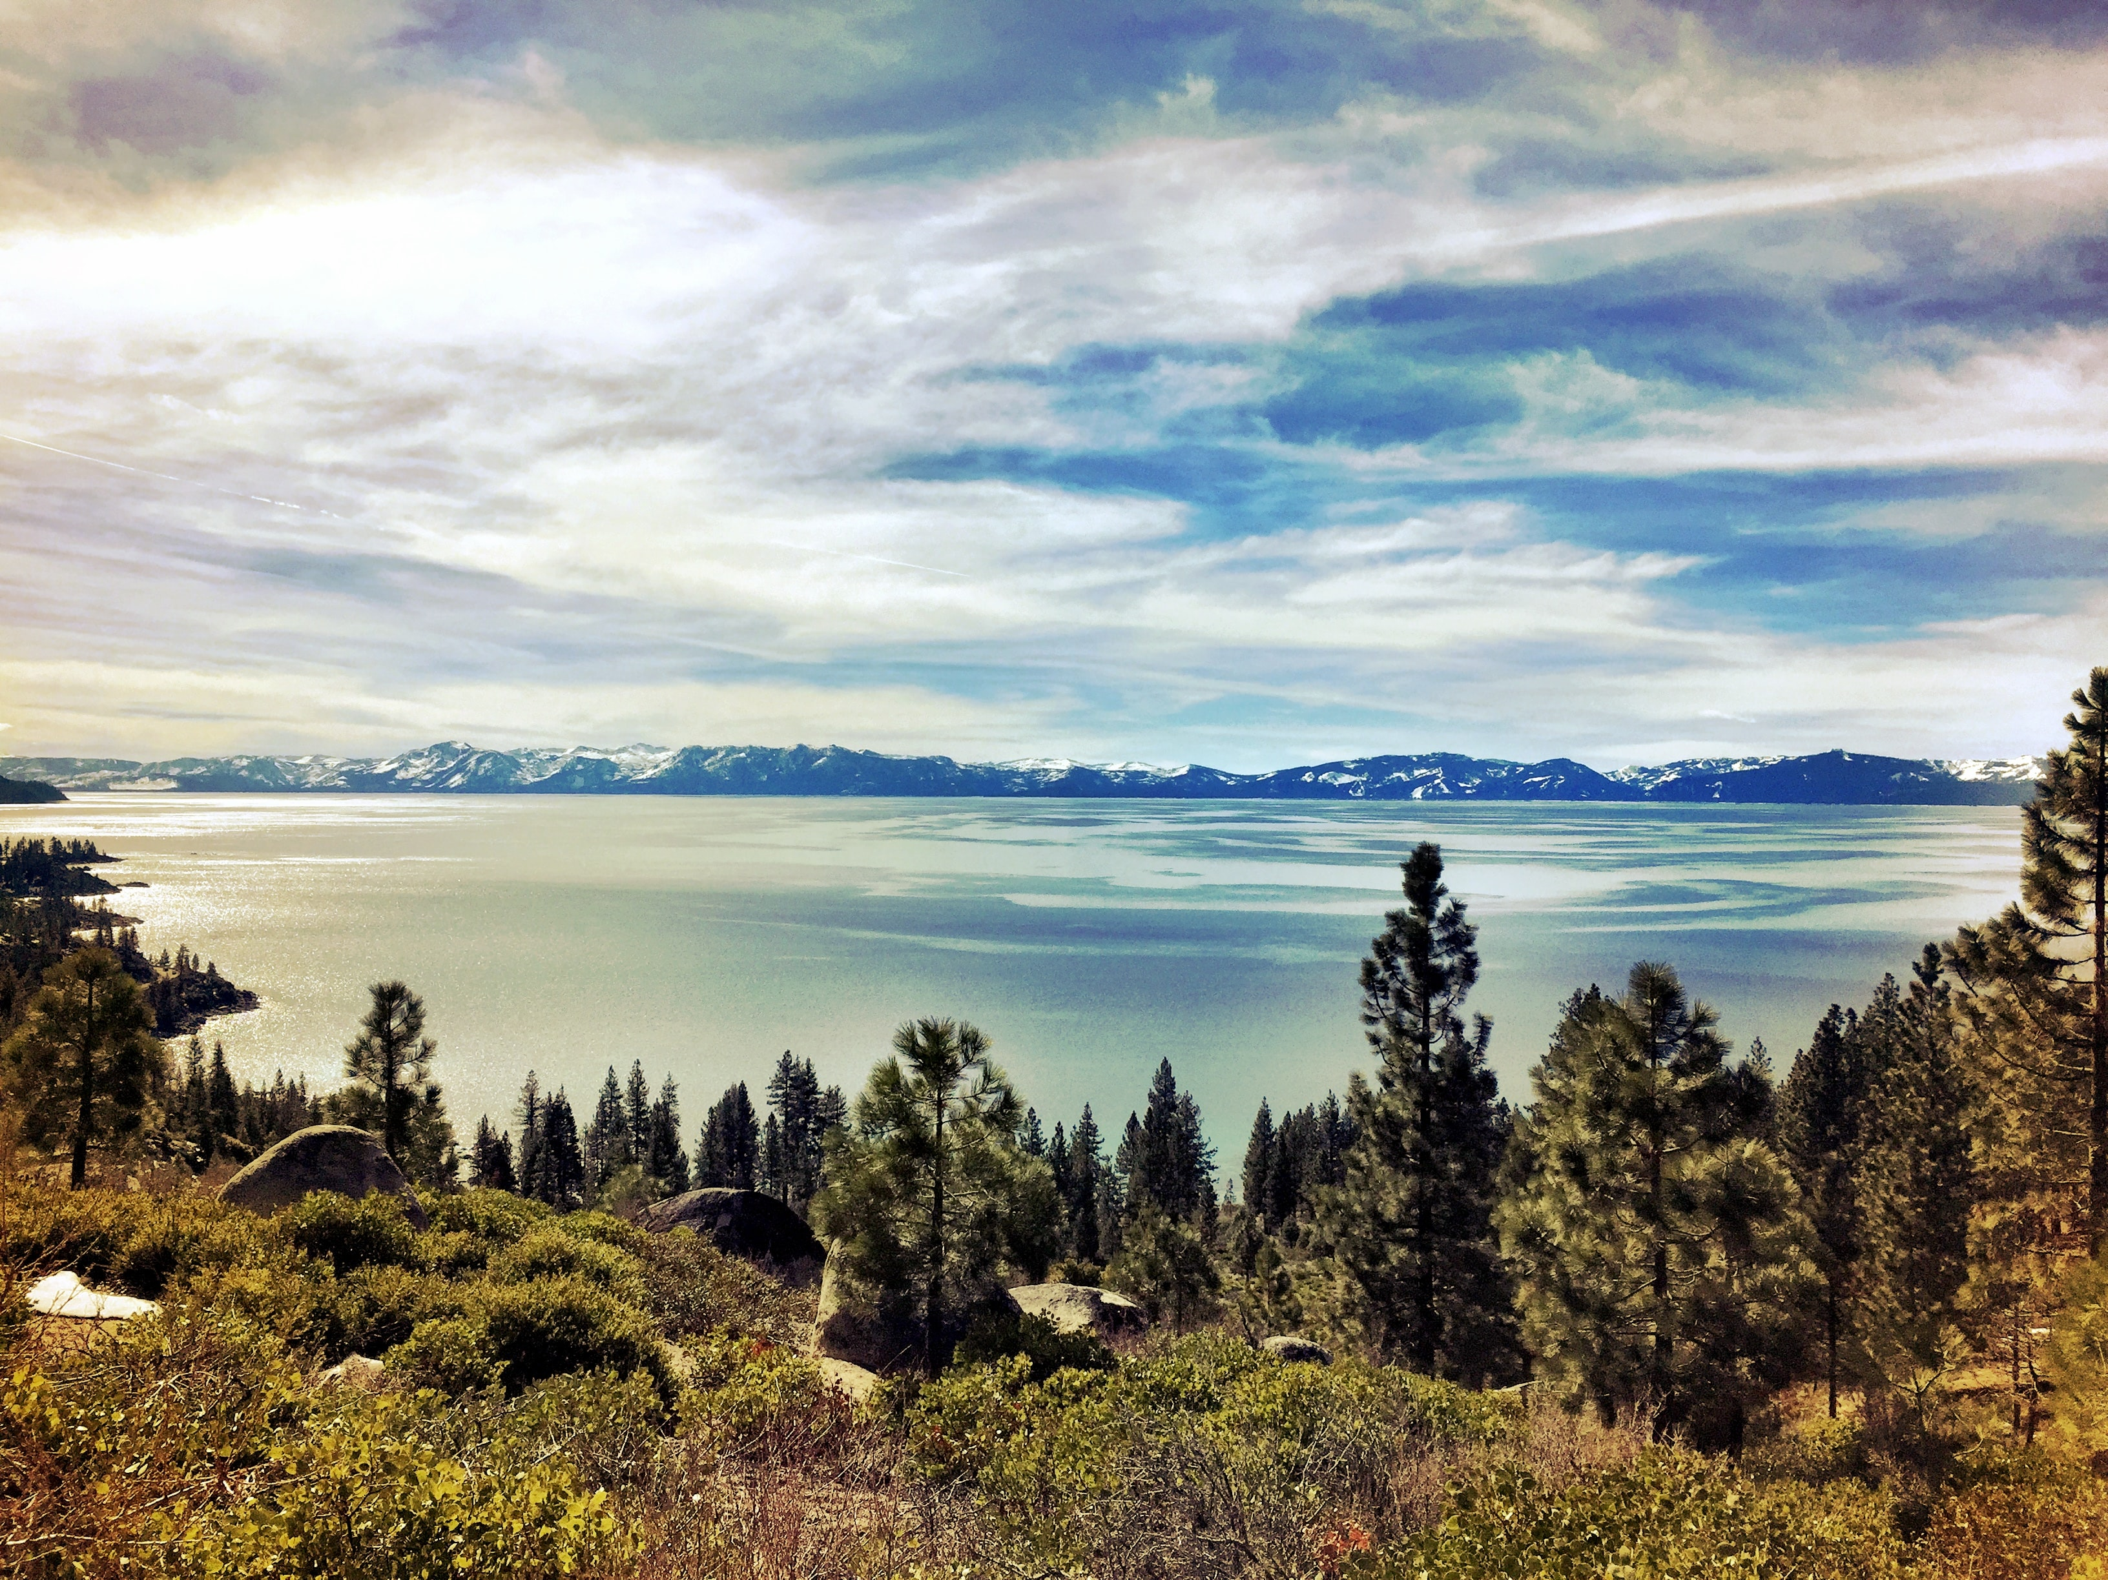
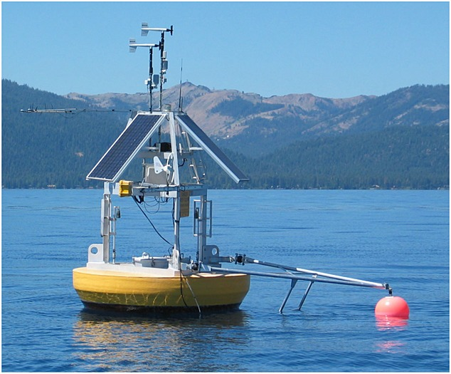
Benefits
CE-QUAL-W2 (W2) will simulate HAB occurrences with greater precision.
W2 will improve understanding of how various environmental factors contribute to HAB dynamics, enabling more proactive management.
W2 outputs will help formulate effective mitigation strategies to reduce the frequency and severity of HAB events by targeting identified key contributing factors.
W2 outputs will facilitate adaptive management practices.
Improve HAB simulation of multiple future scenarios will improve emergency response and sampling.
Early detection and management of HABs will help protect ecosystem health and public safety, minimizing the adverse effects on wildlife and human populations.

Slide 12

Questions?

